Slide 1
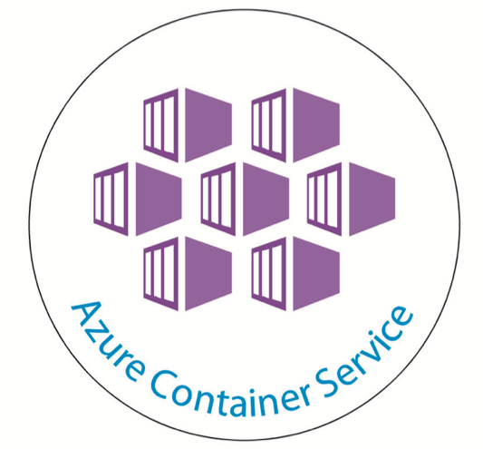
Containerize Java Applications in Azure Container Services with Kubernete

Slide 2
Scope
Use-case 1: Customer wanting to lift and shift Java application 1.6,1.7 first to Cloud and then asking HCL to Upgrade (1.8) and Modernize.
Use-case 2: Customer wanting to lift and shift application which is active (continued changes going on) and the customer is not interested to modernize. CI/CD needs to be enabled for that app.
Use-case 3: Customer wanting to lift and shift Java application 1.6, 1.7 which is active and also asks HCL to modernize (Upgrade to 1.8) it with minimal effort and run it on containers. He does not want to rewrite the application. Here the customer will be interested to know how the containers can be beneficial.

Slide 3
Use-case 1: Customer wanting to lift and shift Java application 1.6,1.7 first to Cloud and then asking HCL to Upgrade (1.8) and Modernize.
Use-case 3: Customer wanting to lift and shift Java application 1.6, 1.7 which is active and also asks HCL to modernize (Upgrade to 1.8) it with minimal effort and run it on containers.
Solution: Same Approach for Java 1.6, Java 1.7, Java 1.8
Two Methods:
1-click deployment from intellJ Software ( Web App to container)
Pushing an Image to Azure Container Registry and then deploying to Kubernetes Cluster
Difference between these two methods:
Kubernete enables deployment of multiple applications in same cluster
Kubernete allows communication between different applications
Kubernete enables scaling individually
Kubernete provides complete management and automatic load balancing facilities

Slide 4
For Java 1.6, 1.7, 1,8 , Prerequisites for deployment to ACS
Eclipse / IntellJ
Docker for Linux
Kubernetes orchestrator
Azure Container Registry
Dockerfile
Deployment file
MySQL Deployment by migrating mySql to Azure
FROM tomcat:8.5-jre8 RUN rm -fr /usr/local/tomcat/webapps/ROOT COPY target/account-1.0-SNAPSHOT.war /usr/local/tomcat/webapps/ROOT.war

Slide 5
To Create Kubernetes on Linux for Java Application
az acs create --orchestrator-type kubernetes --resource-group myResourceGroup --name myK8sCluster --generate-ssh-keys
To connect with Kubernete cluster on Azure from client
az acs kubernetes install-cli
Environment Variable : Path-> C:\Program Files (x86)
az acs kubernetes get-credentials --resource-group=myResourceGroup --name=myK8sCluster
Kubectl proxy
Container Registry
Go to Azure services-> Create New Container Registry

Slide 6
Use-case 2: Customer wanting to lift and shift application which is active (continued changes going on) and the customer is not interested to modernize. CI/CD needs to be enabled for that app.
Solution: For CI/CD approach :
Use Eclipse for VSTS integration
Use IntellJ for other repository integration and using these repository in VSTS for continuous Integration and Continuous Deployment
Prerequisites:
Same as mentioned in Use Case 1
VSTS admin login

Slide 7
Thank You

